Slide 1

CLASSIFICATION OF BREAST CANCER USING MACHINE LEARNING ALGORITHMS
SRM INSTITUTE OF SCIENCE AND TECHNOLOGY
SCHOOL OF COMPUTING
DEPARTMENT OF COMPUTING TECHNOLOGIES
18CSP107L / 18CSP108L - MINOR PROJECT / INTERNSHIP
Batch ID: B071
Student 1 Reg. No: RA2011003010095
Student 1 Name: Parth Garg
Student 2 Reg. No: RA2011003010136
Student 2 Name: Pulkit Sharma
Guide name: U.M. Prakash
Designation: Assistant Professor Department: CTECH

Slide 2
PREDICTION AND CLASSIFICATION OF BREAST CANCER USING MACHINE LEARNING ALGORITHMS
Abstract
Excessive growth of breast cells is the root cause of breast cancer. Breast cancer exists in a variety of forms. Breast cancer is one of the most prevalent malignancies diagnosed today. Many women are being diagnosed with it, and it has been the cause of many deaths. The likelihood of developing cancer needs to be predicted at an early stage so that preventative measures can be followed. Machine learning is a relatively new AI approach, and its efficacy in prediction of cancer was not investigated extensively. In the given research, breast cancer predictions are made by using ML classifiers. Current solutions for Breast Cancer prediction are viable but far from perfect and can be improved upon in many areas. Overtime people have come up with different ways for predicting probability of Cancer. We would try to come up with a solution using various machine learning algorithms that adapts over time so it can stay updated automatically and do the right job. The purpose is to try different machine learning classifying techniques and identify which is having most accuracy. We aim to identify what tumors are benign and which are malignant. As a consequence, this would help identify breast cancer in patients in their early stages. The different classifiers accuracy like, KNN, RFC (Random Forest Classifier), Support Vector Machine Classifier and Naïve Bayes is calculated from the data set (Wisconsin breast cancer dataset). From the results of this experiment, we can see that RFC has best possible accuracy in predicting cancer compared to other ML algorithms.

Slide 3
Introduction
General Overview:
- Breast Cancer results from uncontrolled cell multiplication forming tumors.
- Malignant tumors can spread to other body parts; benign tumors don't spread.
- The term "breast cancer" refers to cancer originating in breast cells.
- Often begins in ducts or lobules of the breast.
Types of Breast Cancer:
- Non-invasive: Stays within milk ducts and lobules.
- Invasive: Spreads to neighboring tissues; considered malignant.
- Subtypes based on microscopic appearance.
Recurrence and Spread:
- Recurrence risk linked to the number of lymph nodes affected.
- Can spread via lymph nodes or bloodstream to organs like lungs, liver, bones, and brain.
- Possible for cancer to return to the initial site of spread.
Breast Cancer Symptoms:
- Symptoms vary; some may be asymptomatic.
- Alarming indicators include:
- Lump in armpits or breasts.
- Breast swelling, skin irritation, or redness.
- Nipple pain, blood discharge, changes in breast shape/size.
Early Prediction and Machine Learning:
- Early prediction crucial for preventing mortality.
- Machine Learning (ML) offers benefits:
- Improved accuracy and reduced errors.
- Faster than traditional methods like biopsy.
- Analyzing past occurrences' features and timelines for recurrence prediction.
Research Example: V. Jain and Mangal [1]:
- AI techniques employed for breast cancer risk assessment.
- ML techniques used: Gradient Boosting Classifier, Decision Tree, Ada Boost Classifier.
- Models trained on a dataset, performance evaluated on a test set.
- SVM approach demonstrated superior performance in this research.

Slide 4
Existing System
Current Approaches:
- Conventional methods for breast cancer diagnosis and prediction.
- Reliance on biopsies, which can be time-consuming and invasive.
- Limited accuracy in some cases.
Challenges with Conventional Methods:
- Biopsy-related delays in diagnosis and treatment.
- Invasive procedures causing discomfort for patients.
- Human error and subjectivity in interpretation.
Limitations:
- Difficulty in predicting recurrence based solely on conventional methods.
- Lack of efficiency in analyzing complex datasets.
Need for Improvement:
- Demand for more accurate, efficient, and non-invasive methods.
- Exploration of advanced technologies like Machine Learning (ML).
Transition to Machine Learning:
- ML offers the potential to enhance accuracy and speed of prediction.
- Analyzing large datasets for patterns and insights.
- Reducing reliance on invasive procedures.

Slide 5
Problem statement and Objectives
3. Early-Stage Identification:
- Identify benign and malignant tumors accurately.
- Enable early-stage detection for timely intervention.
- Contribute to early diagnosis and treatment of breast cancer.
- Enhance overall patient well-being and survival rates.
4. Performance Assessment:
- Evaluate ML models using Wisconsin Breast Cancer database.
- Measure models' accuracy, precision, recall, and F1-score.
5. Optimizing Data Processing:
- Implement effective data preprocessing techniques.
- Select relevant features for optimal model performance.
6. Comparative Analysis:
- Compare accuracy and speed of different ML algorithms.
- Determine the most efficient cancer prediction approach.
7. Improving Patient Outcomes:
Contribute to early diagnosis and treatment of breast cancer.
Enhance overall patient well-being and survival rates.
Problem Statement:
- Current breast cancer prediction methods have limitations.
- There is a need for more accurate and efficient prediction techniques.
Objectives:
1. Enhancing Prediction Accuracy:
- Develop improved breast cancer prediction models.
- Aim for higher accuracy than existing solutions.
2. Adaptive Algorithm Development:
- Create machine learning algorithms that adapt over time.
- Ensure automatic updates for sustained accuracy.

Slide 6
Proposed System
Proposed Solution:
Advanced breast cancer prediction system using machine learning.
Utilizing machine learning techniques for accurate and efficient predictions.
Key Features:
Adaptive Algorithms for ongoing accuracy.
Comprehensive Data Processing for effective analysis.
Early Detection of benign/malignant tumors.
Improved Patient Outcomes through early treatment.
Methodology:
Collect Comprehensive Data including Wisconsin Breast Cancer dataset.
Preprocess Data: Clean, transform, and prepare for analysis.
Extract Features: Identify relevant features.
Develop Adaptive Models for ongoing accuracy.
Evaluate Performance: Measure accuracy, precision, recall, F1-score.
Compare Algorithms for efficiency.
Validate Early Detection effectiveness.
Benefits:
Enhanced Prediction Accuracy.
Timely Cancer Detection.
Adaptive Algorithms.
Data-Driven Insights.

Slide 7
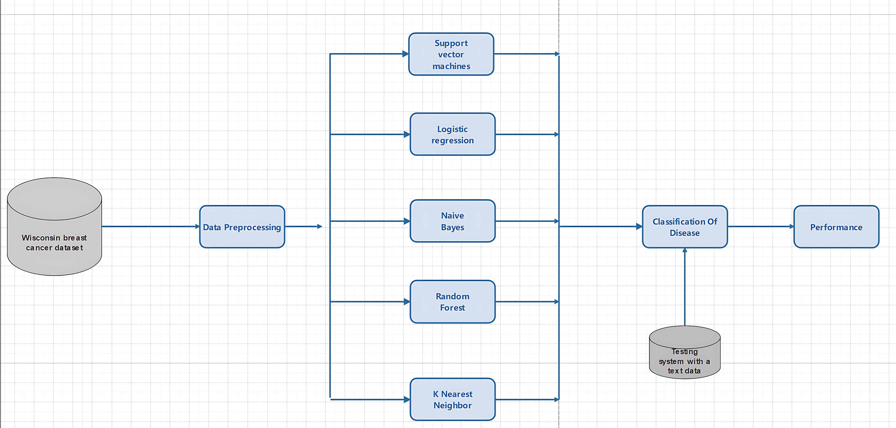
Architecture/Block Diagram of the proposed model

Slide 8
Modules Description

Slide 9
Intermediate Results and Discussion
Progress Update:
Successfully collected and preprocessed comprehensive breast cancer dataset.
Ensured data readiness for subsequent analysis.
Model Advancements:
Developing adaptable ML models.
Algorithms designed for ongoing accuracy.
Performance Assessment:
Initial model evaluation done.
Metrics: accuracy, precision, recall, F1-score.
Algorithm Comparison:
Thoroughly comparing ML algorithms.
Identifying promising predictors.
Early Detection Validation:
Validated system's early cancer identification.
Successful early-stage cancer recognition.
Patient Outcomes Impact:
Early detection linked to better outcomes.
Potential for higher survival rates.

Slide 10
References
Edsger W. Dijkstra. (1961). On the design of machine-independent recursive routines. Numerische Mathematik, 3(1):226–244.
Niklaus Wirth. (1971). The Programming Language PASCAL. Acta Informatica, 1(1):1-19.
Donald E. Knuth. (1968). The Art of Computer Programming, Vol. 1: Fundamental Algorithms. Addison-Wesley.
Shunting-yard algorithm. (2022). In Wikipedia. Retrieved February 10, 2022, from https://en.wikipedia.org/wiki/Shunting-yard_algorithm
Reverse Polish Notation. (2022). In Wikipedia. Retrieved February 10, 2022, from https://en.wikipedia.org/wiki/Reverse_Polish_notation
OpenAI. (2021). GPT-3: Language Models are Few-Shot Learners. Retrieved February 10, 2022, from https://arxiv.org/abs/2005.14165
The C Programming Language. (1988). Brian W. Kernighan and Dennis M. Ritchie. Prentice Hall.

Slide 11
Questions?

